Slide 1
OOP
Design Patterns
Notes:
A Bayley

Slide 2
Learning Outcomes
Students should be able to:
  Understand why patterns are used
  Describe what is a design pattern
  Relate origins of software patterns
  Explain the different categories of design patterns
  Explain the structure and operation of at least four design patterns and implement them in Java

Slide 3
Impetus behind the use of patterns
designing reusable software is hard
novices are overwhelmed
experts draw from experience
some design solutions reoccur
understanding reoccurring solutions is beneficial in several ways
Slide 3 (of 18)
Notes:
3
Whether it has to be accepted or to be changed in the future: Designing reusable software is difficult. There are no hard and fast rules. Experienced designers, however, manage to make good designs. Novices, on the contrary, are not sure which design rule to follow when and do not have a handle to relate problems to solutions.
The "secret" of experienced designers is (amongst other secrets) that they can draw from a rich knowledge base of designs that are known to work. An experienced designer knows when a particular solution is applicable, how it is established, and what consequences are implied by its selection

Slide 4
What is a Pattern?
“Each pattern describes a problem which occurs
over and over again in our environment,
and then describes the core of the solution
to that problem, in such a way that you can use this solution a million times over,
without ever doing it the same way twice.”
.
Christopher Alexander
Slide 5 (of 18)
Notes:
7
6
Expertise often manifests in being able to tell stories about successful design rather than just reciting good design rules.
Christopher Alexander, is a mathematician, architect and a design theorist.

Slide 5
“ A design pattern systematically names, motivates, and explains a general design that addresses a recurring design problem in object-oriented systems. It describes the problem, the solution, when to apply the solution, and its consequences. It also gives implementation hints and examples. The solution is a general arrangement of objects and classes that solve the problem. The solution is customized and implemented to solve the problem in a particular context.”
- Design Patterns Book

Slide 6
Patterns
Patterns are design outlines that apply across a variety of software applications
  To be useful, a pattern must apply across a variety of situations
  To be substantive, a pattern must make some assumptions about the domain of applications to which it applies
Slide 7 (of 18)

Slide 7
What is a Design Pattern?
A design pattern is defined as ‘a description of communicating objects and classes that are customised to solve a general design problem in a particular context’.
Patterns capture good design principles and communicate them to others.
Design patterns represent the first legitimate attempt at design reusability.
Slide 9 (of 18)

Slide 8
Design Patterns: Essentials
Patterns are found through trial and error and by observation.
In general a design pattern has four essential elements:
  The pattern name
  The problem the pattern is used to solve
  The solution or template for implementing the pattern
    Structure, participants, collaborations
  The consequences or results of applying the pattern.
    Tradeoffs, Strengths, weaknesses etc.
Slide 11 (of 18)

Slide 9
Patterns in the S/W Development Lifecycle
Design patterns are considered complementary to existing object-oriented methodologies.
Success in using design patterns largely depends in the correct selection of the appropriate pattern.
Knowledge and understanding of the use of existing documented patterns is all important.
Therefore the way patterns are catalogued must be unambiguous and complete.
Slide 12 (of 18)

Slide 10
The ‘Gang of Four’
It all began in 1990’s when Helm & Gamma recognized these design patterns
As a result of further research the book of ‘Design Patterns: Elements of Reusable Object-Oriented Software’ was published in 1994.
The authors;
  Gamma – Helm – Jhonson – Vlissides

Slide 11
The ‘Gang of Four’
It contains a description of the concepts of patterns, plus a catalog of 23 design patterns with their full documentation.
Slide 13 (of 18)

Slide 12
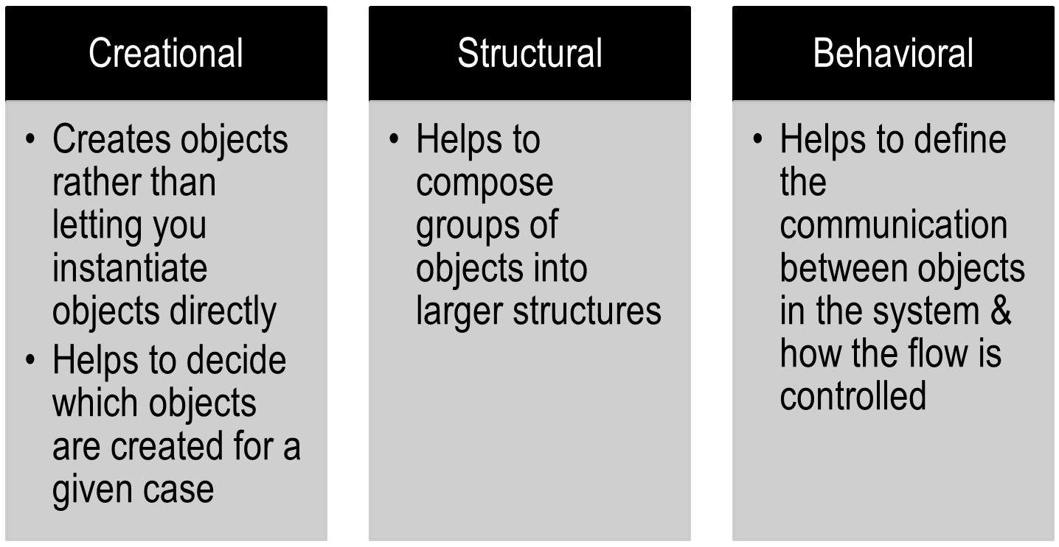
Gang-of-Four Patterns : 3 Categories

Slide 13
Gang-of-Four Patterns
Creational Abstract factory Builder Factory method Prototype Singleton | Structural Adapter Bridge Composite Decorator Façade Proxy | Behavioral Chain of responsibility Command Flyweight Interpreter Iterator Mediator Memento Observer State Strategy Template method Visitor
Slide 15 (of 18)
Notes:
Teaching Notes
There are many other patterns beside the GOF patterns.

Slide 14
Creational Pattern: Singleton
Intent:
  To ensure that a class has only one instance, and to provide a global point of access to it.
Motivation:
  The singleton design pattern describes how to solve such problems:
    Hide the constructor of the class.
    Define a public static operation (getInstance()) that returns the sole instance of the class.
Notes:
There are instances where you need to make sure that there can be one and only one instance of a class.
For example
Your application can have only one windowmanager.
Although you can have many printers in the system there should be only one printspooler.
Only one single point of access to the database engine.
You might wonder why we need to have a separate design pattern for this? Why cant we just use global static variables and get the job done?
Singleton pattern gives us a global point of access but without any downsides. For example if you just use static variables and create a global instance of a class, you might end up wasting resources specially if the instance is resource intensive. With singleton we can create such instances when we require them rather than creating it and keeping before using it.
A Bayley

Slide 15
Creational Pattern: Singleton
The key idea in this pattern is to make the class itself responsible for controlling its instantiation (that it is instantiated only once).
  The hidden constructor (declared private) ensures that the class can never be instantiated from outside the class.
  The public static operation can be accessed easily by using the class name and operation name (Singleton.getInstance()).
Notes:
A Bayley

Slide 16
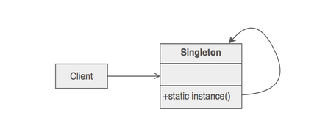
Creational Pattern: Singleton
Structure
Notes:
A Bayley

Slide 17
Creational Pattern: Singleton
We can create a static method in the class to issue and keep track of instances
  To prevent instantiating the class more than once, we can make the constructor private, so an instance of the class can be accessed only from the static method of the class
public class Singleton{
private static Singleton uniqueSingleton = new Singleton();
private Singleton(){}
public static Singleton getInstance(){
return uniqueSingleton;
}
}
Clients of the Singleton can now use that static method to gain access to the Singleton object:
Singleton single = Singleton.getInstance();
Notes:
A Bayley

Slide 18
Creational Pattern: Singleton
Classic Singleton Pattern: Eager Initialization
This is a private static field that holds a reference to a Singleton object
public class Singleton{
private static Singleton uniqueSingleton = new Singleton();
private Singleton(){}
public static Singleton getInstance(){
return uniqueSingleton;
}
}
The constructor is private so that instances can be created only by the class itself.
Eager Initialization
An instance of a class is created much before it is actually required, irrespective of whether any other class actually asked for its instance or not.
Notes:
A Bayley

Slide 19
Creational Pattern: Singleton
Classic Singleton Pattern: Lazy Initialization
public class Singleton{
private static Singleton uniqueSingleton;
private Singleton(){}
public static Singleton getInstance(){
    if(uniqueSingleton == null)
    uniqueSingleton = new Singleton();
    return uniqueSingleton;
}
}
Checks to see if the object has already been created.
The constructor is private so that instances can be created only by the class itself.
This is a private static field that holds a reference to a Singleton object
Lazy Initialization
Is the tactic of delaying the creation of an object until the first time it is needed.
In singleton, we should restrict the creation of instance until requested for the first time.
Notes:
A Bayley

Slide 20
Creational Pattern: Singleton
Singleton Consequences
  Because the Singleton class encapsulates its sole instance, it can have strict control over who accesses it and how
  The getInstance() method can keep track of how many classes have "checked out" the instance
Notes:
A Bayley

Slide 21
Structural Design Pattern: Decorator
Intent
  Attach additional responsibilities to an object dynamically. Decorators provide a flexible alternative to sub classing for extending functionality.
Motivation
  We use inheritance to extend the behavior of an object but this is done at compile time and its applicable to all the instances of the class. We can’t add any new functionality to remove any existing behavior at runtime – this is when Decorator pattern comes into picture.
Notes:
For example lets say we have 8 objects but 3 of them needs some different additional features. Then you may have to create 3 derived classes, but if one of these classes has features of the other two classes, then it would become very complex and confusing.
Therefore with decorator pattern we can attach additional responsibilities to an object dynamically (without any confusions). It will help extend functionality of objects without affecting any other object. Decorators provide an alternative to subclassing.
A Bayley

Slide 22
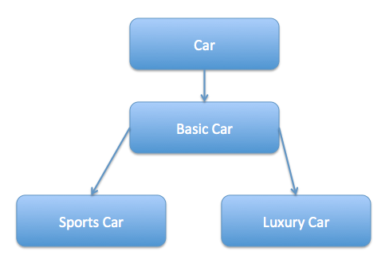
Suppose we want to implement different kinds of cars – we can create interface Car to define the assemble method and then we can have a Basic car, further more we can extend it to Sports car and Luxury Car. The implementation hierarchy will look like below image.
Notes:
But if we want to get a car at runtime that has both the features of sports car and luxury car, then the implementation gets complex
Now imagine if we have ten different kind of cars, the implementation logic using inheritance and composition will be impossible to manage. To solve this kind of programming situation, we apply decorator pattern in java.
A Bayley

Slide 23
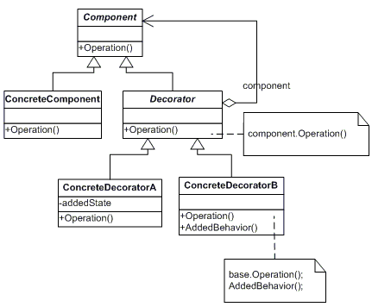
Structural Design Pattern: Decorator
Structure
Slide 1 (of 18)

Slide 24
Structural Design Pattern: Decorator
Participants:
  Component: Defines the abstract class/ interface for objects that can have additional responsibilities added to them.
  ConcreteComponent: Defines an object on which additional responsibilities can be added
  Decorator: Maintains a reference to component object and defines a class that conforms to component's class. In simple words, it has a component object to be decorated.
  ConcreteDecorator: Add responsibilities to the component object.
Slide 1 (of 18)

Slide 25
Structural Design Pattern: Decorator
public interface Window{
public abstract String draw();
}
public class SimpleWindow implements Window{
@Override
public String draw()
{
return "My simple Window";
}
}

Slide 26
Structural Design Pattern: Decorator
public class WindowDecorator implements Window{
protected Window window;
public WindowDecorator(Window w)
{
this.window=w;
}
@Override
public String draw()
{
return this.window.draw();
}
}
public class BorderDecorator extends WindowDecorator {
public BorderDecorator(Window w){
super(w);
}
@Override
public String draw(){
return super.draw() + addBorder();
}
public String addBorder(){
return " + with a border";
}
}

Slide 27
Structural Design Pattern: Decorator
public class VerticalScrollBarDecorator extends WindowDecorator {
public VerticalScrollBarDecorator(Window w){
super(w);
}
@Override
public String draw(){
return super.draw() + addVerticalScrollBar();
}
public String addVerticalScrollBar(){
return " + with a vertical scrollbar";
}
}
public class HorizontalScrollBarDecorator extends WindowDecorator {
  public HorizontalScrollBarDecorator(Window w){
  super(w);
  }
  @Override
  public String draw(){
return super.draw() + addHorizontalScrollBar();
}
  public String addHorizontalScrollBar(){
  return " + with a horizontal scrollbar";
  }
}

Slide 28
Structural Design Pattern: Decorator
public class DecoratorDesignPatternMain {
public static void main(String args[]) {
Window window = new BorderDecorator(
new VerticalScrollBarDecorator(
new SimpleWindow()));
System.out.println(window.draw());
}
}
Object composition is used to wrap basic object with additional responsibilities and these responsibilities can be mixed as needed

Slide 29
Structural Design Pattern: Decorator
Use this pattern when extension by sub-classing is impractical.
  Sometimes, a large number of independent extensions are possible and would produce an explosion of subclasses to support every combination.
Decorator design pattern is helpful in providing runtime modification abilities and hence more flexible. Its easy to maintain and extend when the number of choices are more.
The disadvantage of decorator design pattern is that it uses a lot of similar kind of objects (decorators).
Slide 5 (of 12)

Slide 30
Behavioural Design Pattern: Observer
Intent:
  Define a one-to-many dependency between objects so that when one object changes state, all its dependents are notified and updated automatically.
Motivation:
  The cases when certain objects need to be informed about the changes occurred in other objects are frequent in object orientation. The Observer Design Pattern can be used whenever a subject has to be observed by one or more observers.
Slide 4 (of 19)
Notes:
Also Known As: Dependents, Publish-Subscribe
Essentials of Visual Modeling w/ UML 2.0 - Instructor Notes

Slide 31
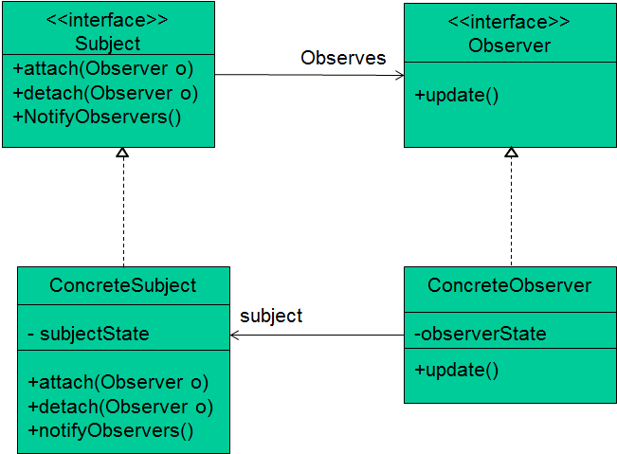
Behavioural Design Pattern: Observer
Structure:
Slide 1 (of 18)
Notes:
Each subject can have many observers.
All potential observers need to implement the observer interface. This interface has just one method, update() that gets called when the Subject’s state changes.
Concrete observers can be any class that implements the observer interface. Each observer registers with a concrete subject to receive updates.
Subject interface is used by observers to attach and detach themselves from being observers.
A concrete subject implements the subject interface. Notify() is used to update all the current observers when ever the state changes.
Essentials of Visual Modeling w/ UML 2.0 - Instructor Notes

Slide 32
Behavioural Design Pattern: Observer
Participants
  Subject: Provides an interface for attaching and detaching observer objects. Any number of observer objects may observe a subject.
  Observer: Defines an updating interface for objects that should be notified of change
  Concrete Subject: Stores state of interest to concrete observer objects. Send notification to it's observers.
  Concrete Observer: Implements the observer updating interface to keep its state consistent with the subject’s.
Slide 1 (of 18)
Notes:
A Bayley

Slide 33
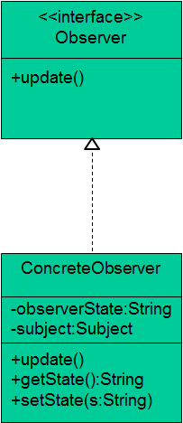
Behavioural Design Pattern: Observer
public interface Observer {
public void update();
}
public class ConcreteObserver implements Observer{
private String observerState;
private Subject subject;
public ConcreteObserver(Subject subject){
this.subject = subject;
this.subject.attach(this);
}
public void update(){
setState(this.subject.getState());
}
public String getState()
{
return observerState;
}
public void setState(String state)
{
observerState = state;
}
}

Slide 34
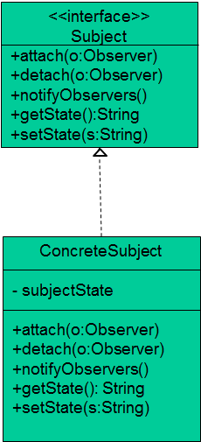
public interface Subject{
public void attach(Observer o);
public void detach(Observer o);
public void notifyObservers();
public String getState();
public void setState(String s);
}
public class ConcreteSubject implements Subject{
List<Observer> observerList = new ArrayList<Observer>();
private String subjectState;
public String getState()
{
return subjectState;
}
public void setState(String s)
{
this.subjectState = s;
notifyObservers();
}
public void attach(Observer o)
{
observerList.add(o);
}
public void detach(Observer o)
{
observerList.remove(o);
}
public void notifyObservers()
{
for (Observer observer : observerList)
{
observer.update();
}
}
}
Notes:
A Bayley

Slide 35
Behavioural Design Pattern: Observer
public class ObserverDesignPatternMain {
public static void main( String[] args ) {
ConcreteSubject sub = new ConcreteSubject();
//Client need to register observer objects to the subject
ConcreteObserver obs = new ConcreteObserver(sub);
sub.setState("State Changed!!!");
System.out.println(obs.getState());
}
}
When the subject’s state changing method is called, internally all registered observers (subscribers) gets updates of that change
This prints
State Changed!!!

Slide 36
Behavioural Design Pattern: Observer
Applicability:
Use Observer pattern when
  A change to one object requires changing others, and you don’t know how many objects need to be changed.
  An object should be able to notify other objects without knowing the internal details about who these objects are. In other words, you don’t want these objects tightly coupled.
Slide 5 (of 19)

Slide 37
Behavioural Design Pattern: Observer
Consequences
  Loose coupling between Subject and Observer: Only thing subject know about its observers is that observer implements Observer interface. You can register or delete any observer without affecting subject.
  Support for broadcast communication: Notification about subject state change does not need to specify its receiver. This notification is broadcasted to all interested object that subscribed to it.
Slide 1 (of 18)

Slide 38
Behavioural Design Pattern: Observer
Consequences
  Debugging become very hard if you have large number of subscribers because flow of control is implicit between subject and observers.
  Unexpected updates: Because observers have no knowledge of each other's presence, they can be blind to the ultimate cost of changing the subject. It lead to spurious updates.
Slide 1 (of 18)

Slide 39
References and Reading
Gamma E, Helm R, Vlissides J & Johnson R. (1994), Design Patterns Elements of Reusable Object-Oriented, Software Addison-Wesley
Cooper J. W., (2000) Java Design Patterns: A Tutorial
Eric Freeman, Elisabeth Robson, Bert Bates, Kathy Sierra (2004), Head First Design Patterns, A Brain-Friendly Guide
http://www.javacamp.org/designPattern/

